Slide 1
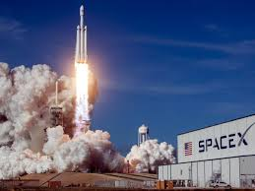






SpaceX Launch Stage 1 Outcome Analysis
Josh Flieder
22 June, 2022

Slide 2



OUTLINE
Executive Summary
Introduction
Methodology
Data collection
Data wrangling
Predictive analysis
Results
Interactive visual analytics
Predictive analysis
Visual results
SQL results
Interactive Folium map
Plotly Dashboard
Predictive analysis
Discussion
Findings and Implications
Conclusion
Appendix

Slide 3
EXECUTIVE SUMMARY
Data was collected from a SpaceX API as well as scrapped from a Wikipedia page
Missing data was treated and relevant data was then analyzed
Plots, queries, and dashboards were made to visualize the data.
V1.1 boosters have a poor success rate
KSC launches have the best results with B4 boosters, and with launch payloads under 5.5k kg
CCAFS LC launches have the best results with FT boosters
Launches to the ES-L1, GEO, HEO, and SSO orbits have not resulted in failures.

Slide 4
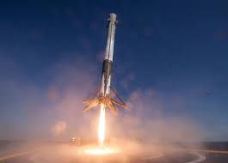
INTRODUCTION
Reuse of stage 1 saves significant money for SpaceX
SpaceY requires the knowledge of SpaceX’s success in saving stage 1 from launches
How has SpaceX done in saving stage 1?
Will future SpaceX launches succeed?
What factors effect SpaceX launch success?
Launch site
Payload
Booster version
Orbit
Etc.

Slide 5
METHODOLOGY: Collection and Wrangling
Data sources for SpaceX launches:
https://api.spacexdata.com/v4/launches/past
https://en.wikipedia.org/w/index.php?title=List_of_Falcon_9_and_Falcon_Heavy_launches&oldid=1027686922
Data wrangling:
Functions were used to grab desired columns of data
Non-Falcon 9 launches were filtered out
Unknown payload masses replaced with average value

Slide 6
METHODOLOGY: EDA
Check for success/failure of missions by plotting relationships:
Payload mass vs flight number
Launch site vs flight number
Launch site vs payload mass
Orbit vs flight number
Orbit vs payload mass
Look into success percentages by orbit
Track yearly success overall

Slide 7
METHODOLOGY: EDA and Viz Analytics
Check success of launches with heaviest payloads
Compare totals of failures vs successes
Investigate relationship between booster version and payload mass
Find the average payload
Count successes and failures for each launch site
Use Folium module and marker clusters

Slide 8
METHODOLOGY: Predictive analysis
Predictive analysis preparation:
Data normalized with sklearn preprocessing.StandardScaler()
Data prepared with train_test_split w/ test size = 0.2 and random state = 2
Test set consisted of 18 samples
Logistic regression GridSearch conducted
“C":[0.01,0.1,1]
'penalty':['l2']
'solver':['lbfgs']}
cv = 10
SVM GridSearch conducted
'kernel':('linear', 'rbf','poly','rbf', 'sigmoid')
'C': np.logspace(-3, 3, 5)
'gamma':np.logspace(-3, 3, 5)
cv = 10

Slide 9
METHODOLOGY: Predictive analysis
Decision Tree Classifier GridSearch conducted
'criterion': ['gini', 'entropy']
'splitter': ['best', 'random']
'max_depth': [2*n for n in range(1,10)]
'max_features': ['auto', 'sqrt']
'min_samples_leaf': [1, 2, 4]
'min_samples_split': [2, 5, 10]}
cv = 10
K-Nearest Neighbors GridSearch conducted
'n_neighbors': [1, 2, 3, 4, 5, 6, 7, 8, 9, 10]
'algorithm': ['auto', 'ball_tree', 'kd_tree', 'brute']
'p': [1,2]
cv = 10

Slide 10
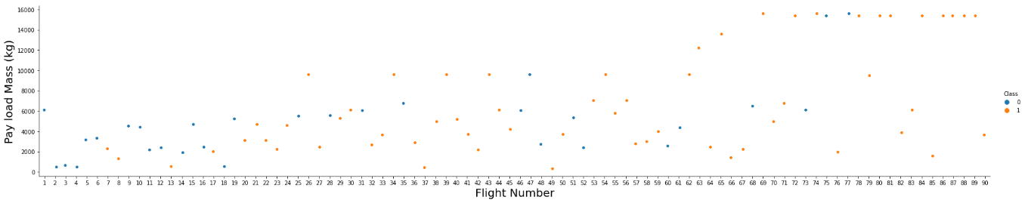
RESULTS: EDA with Visualization
Success rate appears to increase as flights progressed, and tended to increase with heavier payload masses

Slide 11
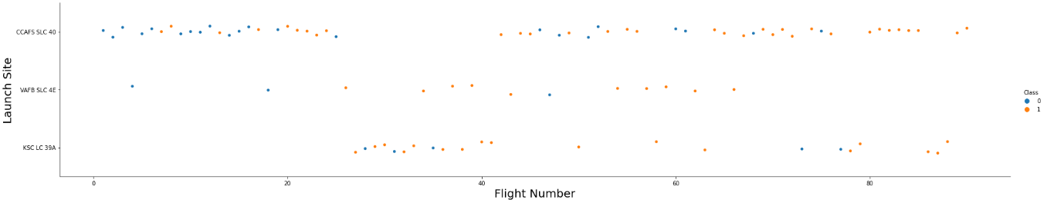
RESULTS: EDA with Visualization
CCAFS has the highest number of successes overall

Slide 12
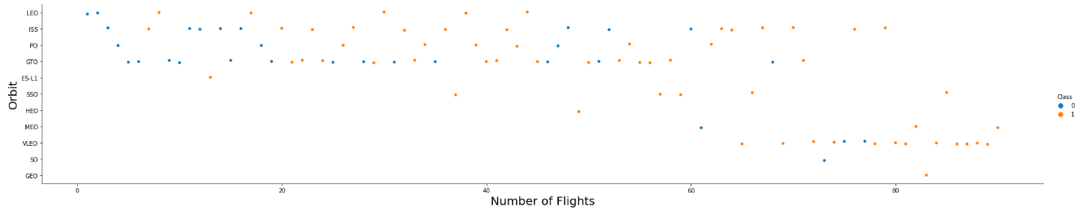
RESULTS: EDA with Visualization
Orbit vs number of flights shows nothing in particular

Slide 13
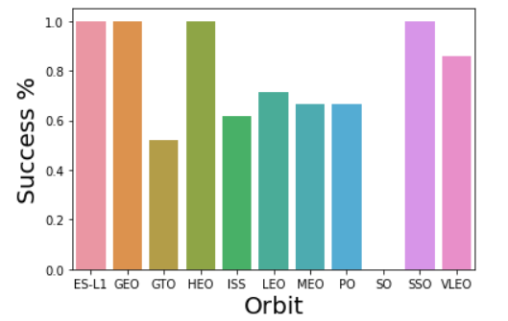
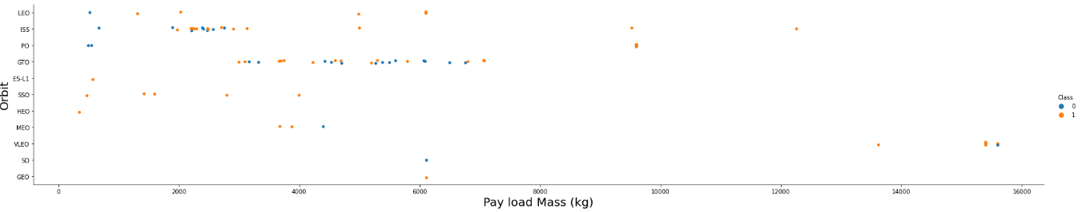
RESULTS: EDA with Visualization
Launches to the SO orbit have no successes
Launches to the following orbits have only successes:
ES-L1
GEO
HEO
SSO

Slide 14
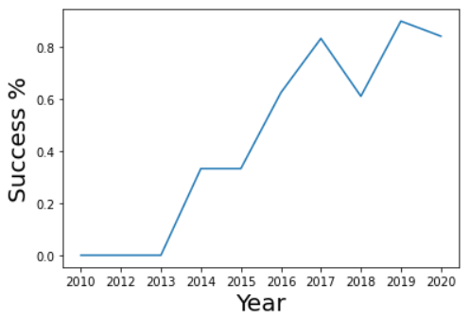
RESULTS: EDA with Visualization
SpaceX’s success rate has generally, but not without exception, trended upwards over time

Slide 15
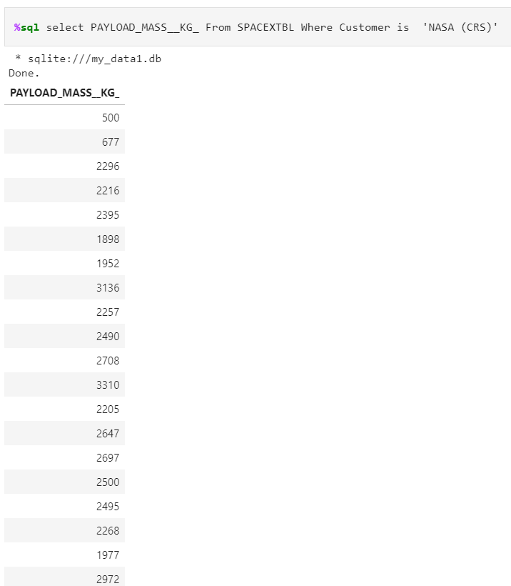
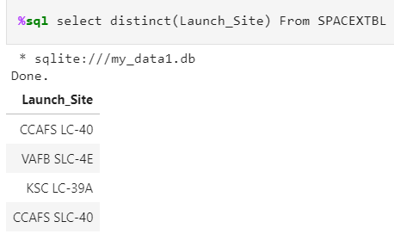
RESULTS: EDA with SQL
Here are the four unique launch sites:
Here are the payload masses of NASA CRS launches:

Slide 16
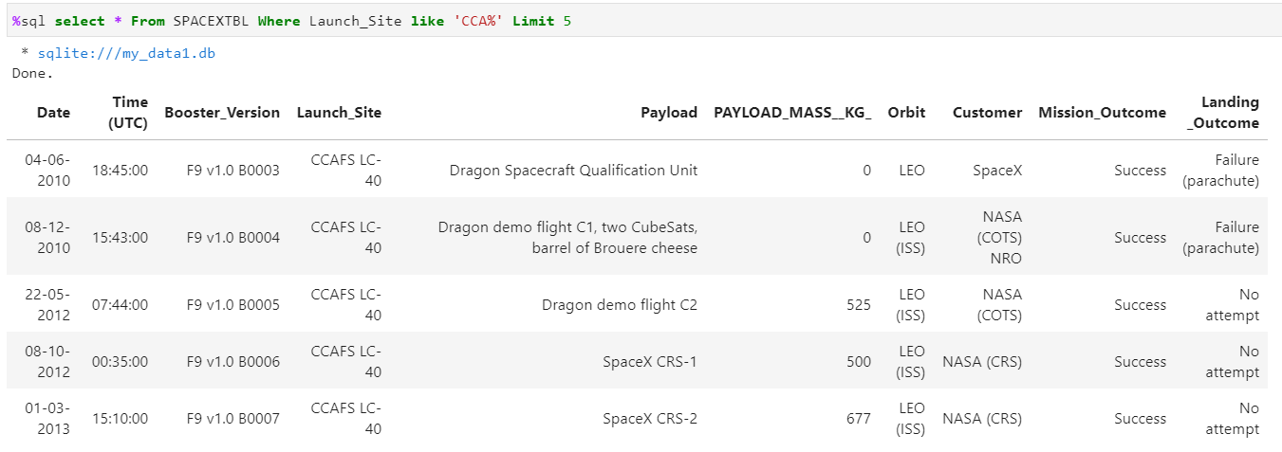
RESULTS: EDA with SQL
Here are the first 5 records from a launch site beginning with CCA:

Slide 17
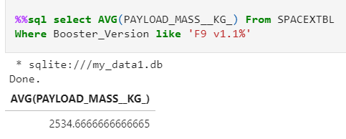
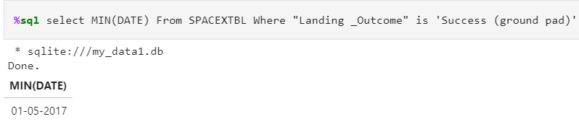
RESULTS: EDA with SQL
The average payload mass in kg:
The date of the first successful ground pad launch:

Slide 18
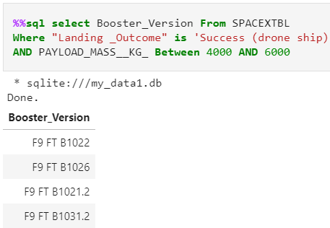
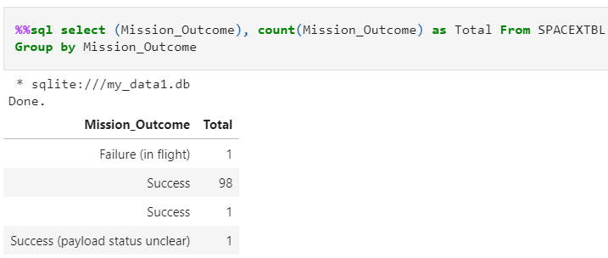
RESULTS: EDA with SQL
The boosters between 4k and 6k kg that landed successfully on a drone ship
The count of all launch outcomes

Slide 19
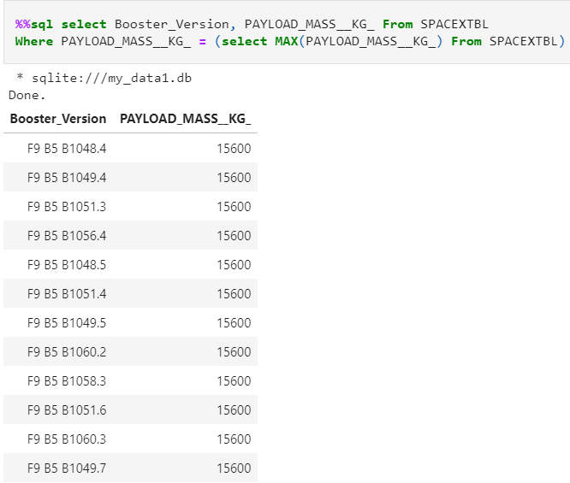
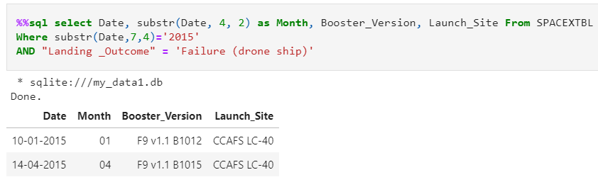
RESULTS: EDA with SQL
Booster versions which carried the maximum launched payload mass
Details on the failed drone ship landings in 2015

Slide 20
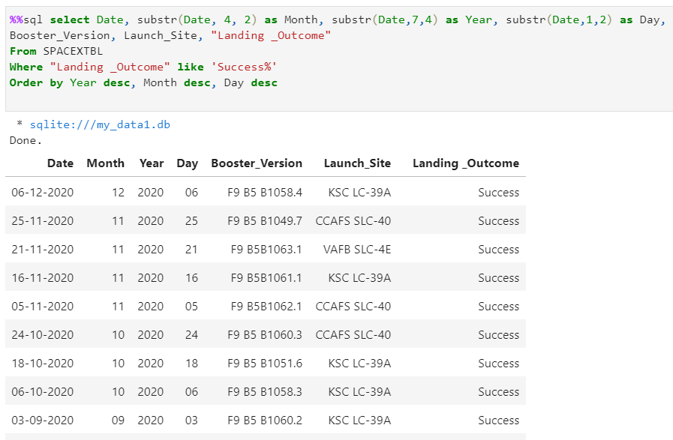
RESULTS: EDA with SQL
Count of successful landing_outcomes between the date 04-06-2010 and 20-03-2017 in descending order

Slide 21
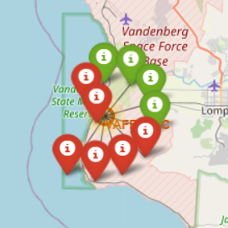
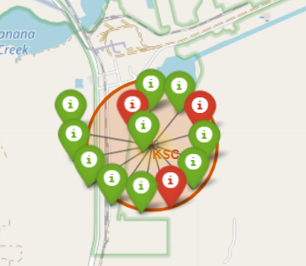
RESULTS: Folium
Here is are the launches from VAFB:
Here is are the launches from KSC:

Slide 22
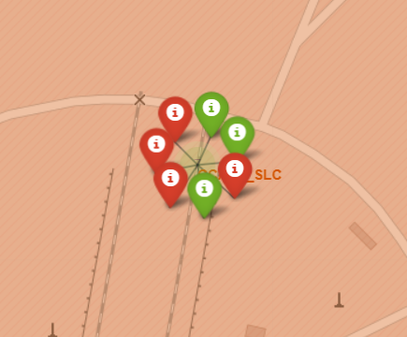
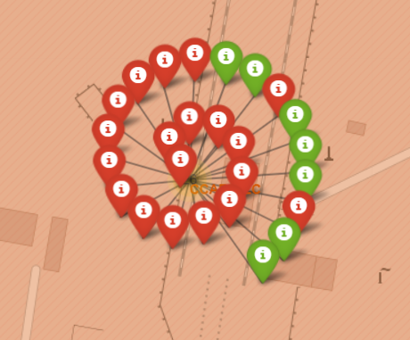
RESULTS: Folium
Here is are the launches from CCAFS_SLC:
Here is are the launches from CCAFS_LC:

Slide 23
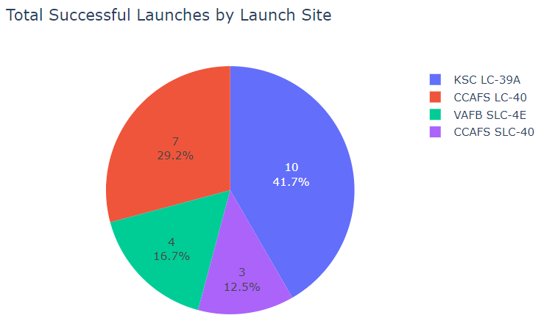
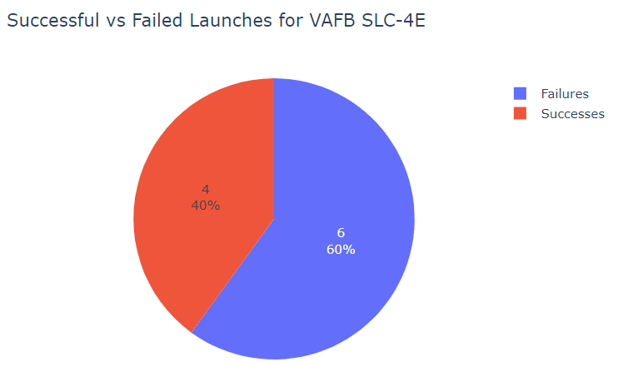
RESULTS: Plotly Dashboard
Here is the distribution of successful launches amongst the launch sites:
Here are the failure and success counts/percentages of launches from VAFB

Slide 24
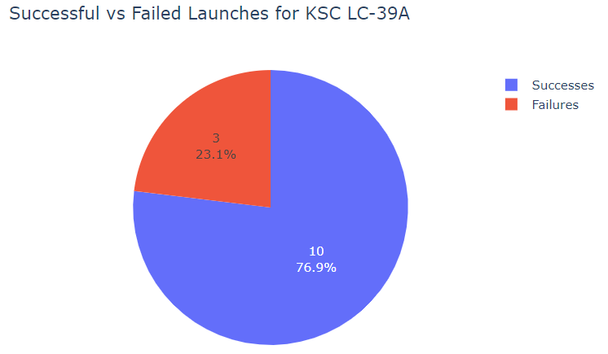
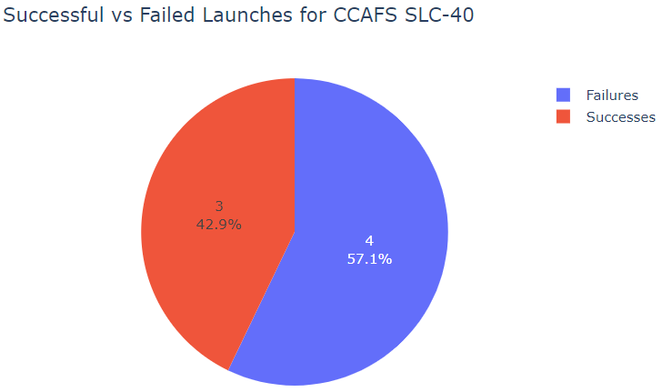
RESULTS: Plotly Dashboard
Here are the failure and success counts/percentages of launches from KSC
Here are the failure and success counts/percentages of launches from CCAFS SLC

Slide 25
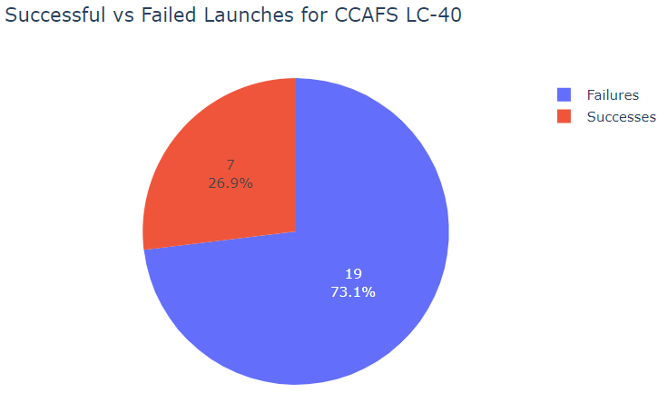
RESULTS: Plotly Dashboard
Here are the failure and success counts/percentages of launches from CCAFS LC

Slide 26
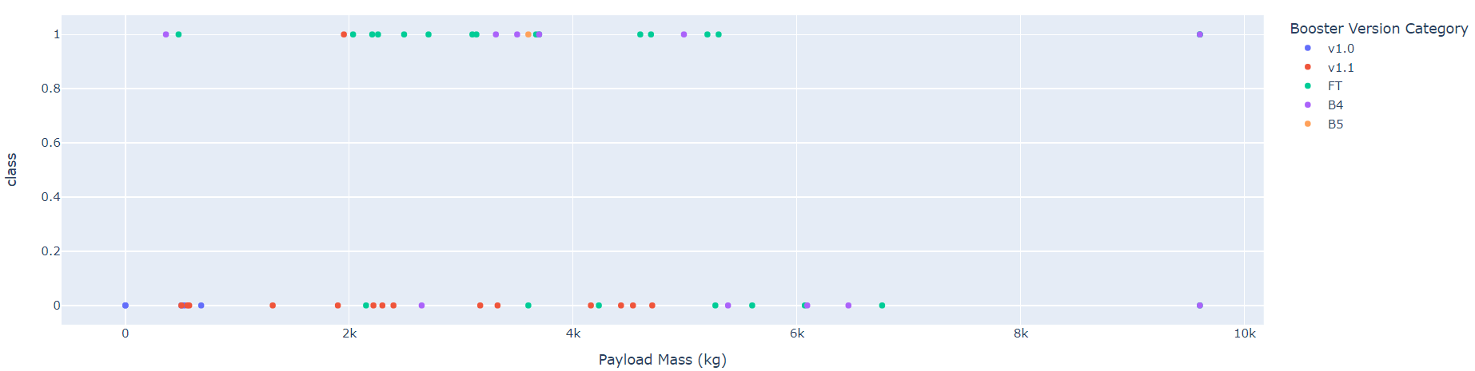
RESULTS: Plotly Dashboard
Here is the spread of successes and failures broken down by payload mass and booster version for all launches

Slide 27
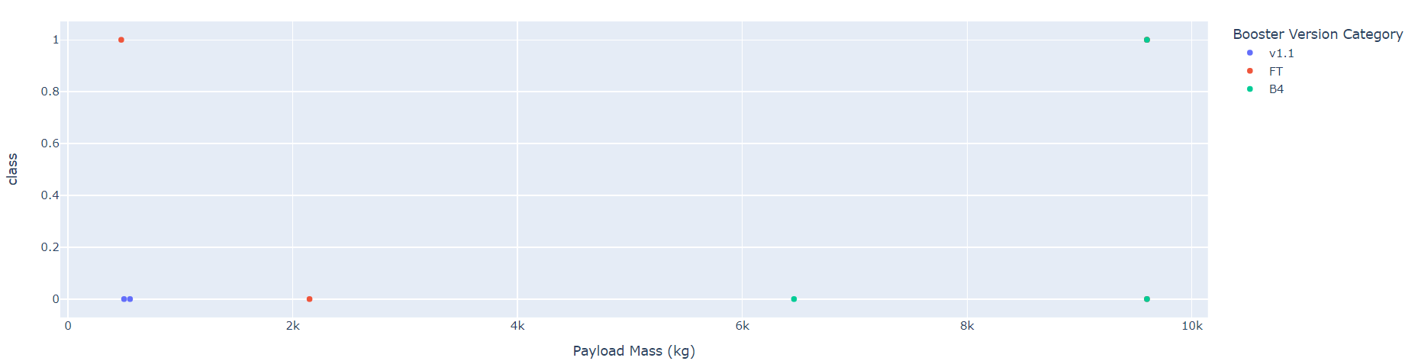
RESULTS: Plotly Dashboard
Here is the spread of successes and failures broken down by payload mass and booster version for launches from VAFB

Slide 28
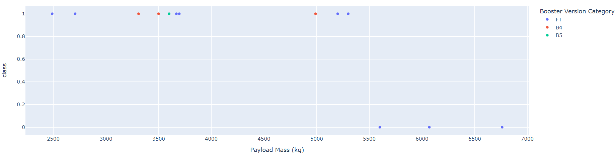
RESULTS: Plotly Dashboard
Here is the spread of successes and failures broken down by payload mass and booster version for launches from KSC

Slide 29

RESULTS: Plotly Dashboard
Here is the spread of successes and failures broken down by payload mass and booster version for launches from CCAFS SLC

Slide 30
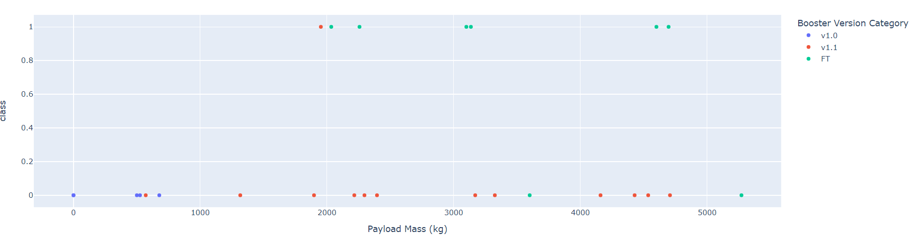
RESULTS: Plotly Dashboard
Here is the spread of successes and failures broken down by payload mass and booster version for launches from CCAFS LC

Slide 31
RESULTS: Predictive Analysis
The calculated accuracies of the GridSearch models used were:
Logistic regression: 82.22%
SVM: 82.22%
Decision tree classifier: 88.88%
K-Nearest Neighbors: 84.44%
Therefore, the best model to use going forward is the Decision tree classifier.

Slide 32
CONCLUSION
KSC is the launch site with the best success rate based on the Folium and Plotly results
FT boosters carrying a payload under 6k kg have a good success rate
V1.1 boosters have a poor success rate
KSC launches have the best results with B4 boosters, and with launch payloads under 5.5k kg
CCAFS LC launches have the best results with FT boosters
Launches to the ES-L1, GEO, HEO, and SSO orbits have not resulted in failures.

